Slide 1
Predicting Bike Sharing Demand in Cities
Modupeola Fagbenro, Crystal Kao, Guruksha Gurnani, Shanun Randev
DATS6101

Slide 2
Background
In large cities where traffic is high and distance between destinations is short, bike sharing has become an alternative form of transportation
Bike sharing is being able to rent a bike at set locations with no need to return them to the original bike rack as there are multiple locations across a city that you can return them to
Data Source: https://www.kaggle.com/competitions/bike-sharing-demand/data
Literature Review
There have been three generations of bike-sharing systems over the past 45 years (DeMaio, 2003-2004). It started in 1965 in Amsterdam but the program died within days.
In 1991, Denmark attempted bike-sharing again but continued to have issues with theft. This led to the creation of customer tracking (Nielse, 1993).
The 3rd attempt was in England in 1996 and included electronically-locking racks or bike locks, telecommunication systems, smart cards and fobs, mobile phone access, and on-board computers.

Slide 3
SMART Questions
Which variables are useful for predicting the number of bikes used in an hour?
How does temperature affect the number of bikes in use?
When do casual bikers increase the most?
Can we estimate when it is a holiday depending on other bikeshare factors?
How can we predict temperature depending upon other important features?

Slide 4
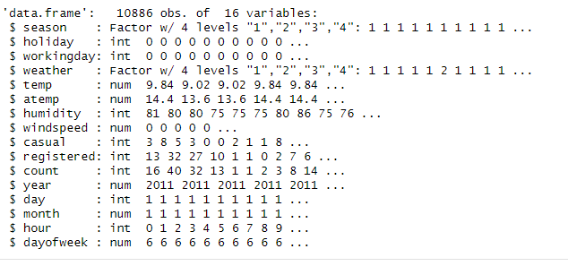
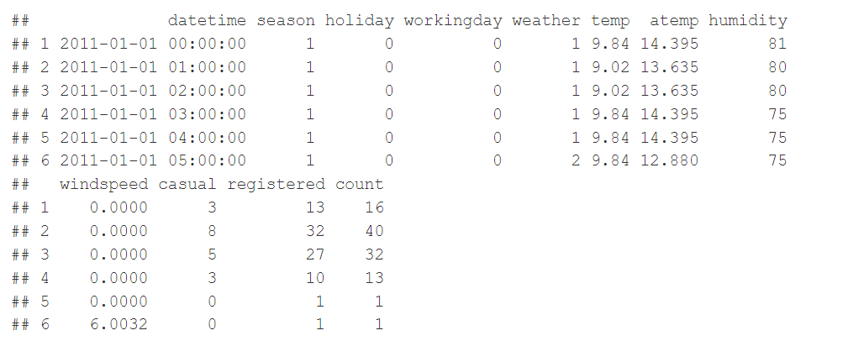
Data Description
Structure of dataset
Glimpse of what the dataset consists of

Slide 5
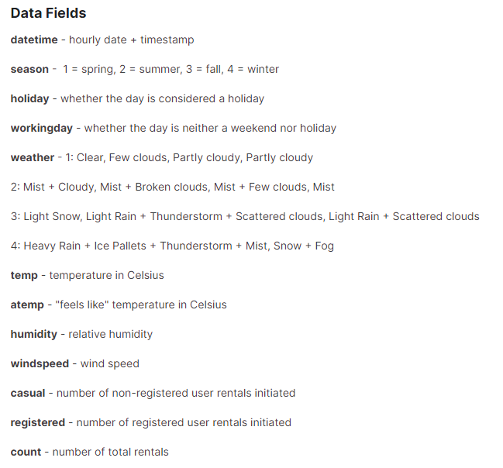
Variable Definitions

Slide 6
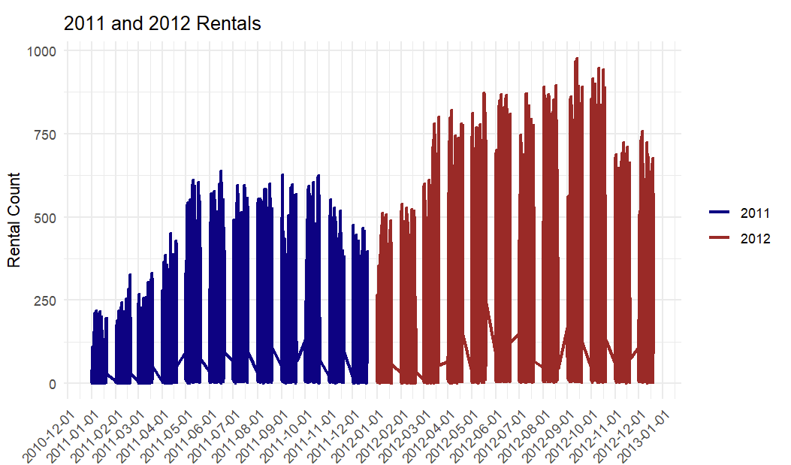
All Rental Data by Month for 2011-2012
There were more bike rentals in 2012 compared to 2011, and for both years, there were the most bike rentals during the summer and fall months

Slide 7
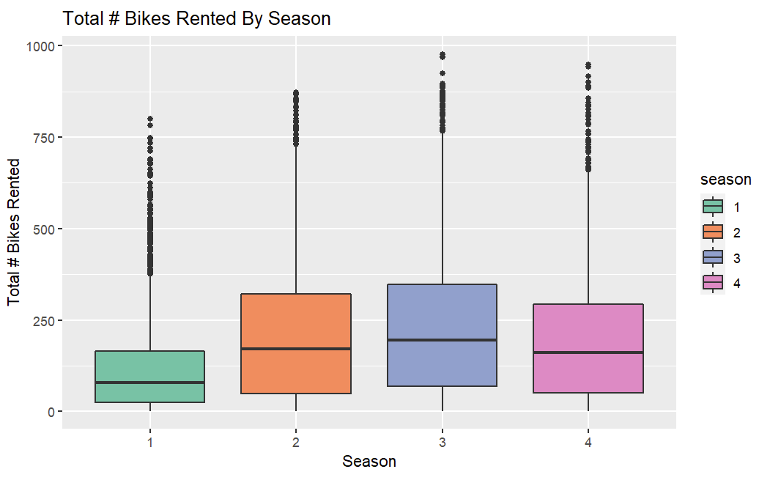
Bike Rentals by Seasons
Spring
Summer
Fall
Winter
When comparing by season, the graphs also shows the most bike rentals were during the summer and fall months

Slide 8
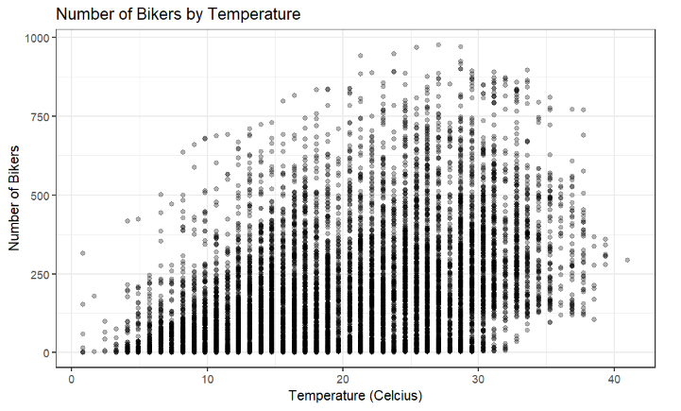
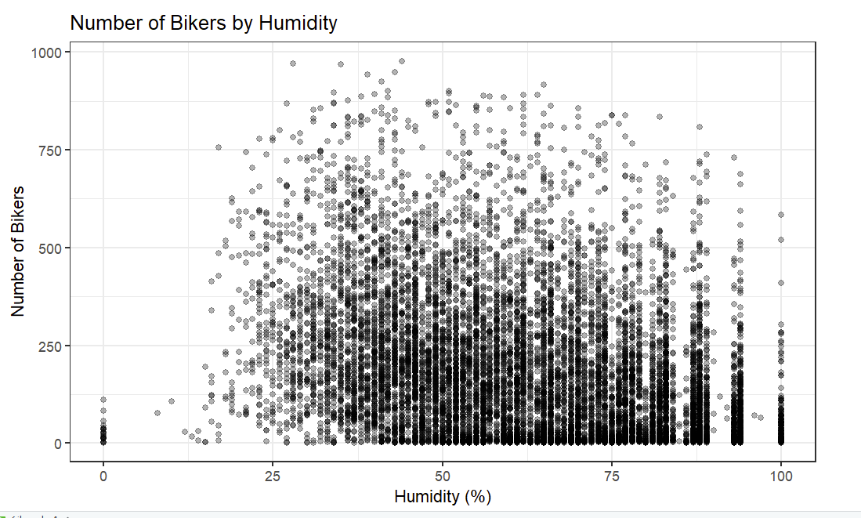
Bike Rentals by Temperature and Humidity
SMART Question: How does temperature affect the number of bikes in use?
The number of bike rentals increased when temperatures increased but dropped off once temperatures started reaching the high 30s (Celsius). The number of bike rentals also increased with increased humidity.

Slide 9
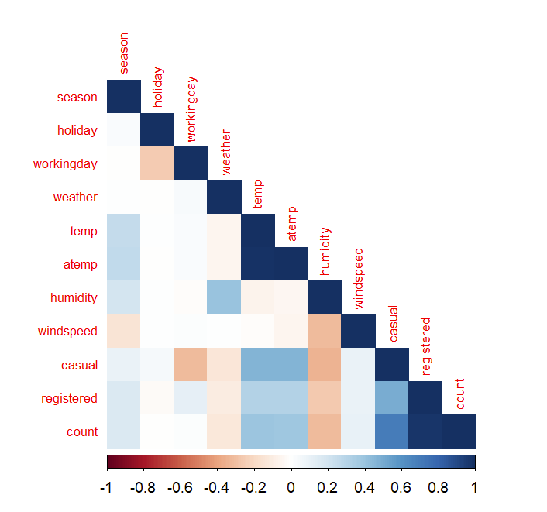
Correlation of Continuous Variables
From the heatmap of correlations shown to the right, it can be concluded that:
temperature (temp) and feeling temperature (atemp) have high positive correlation
count and registered also have high positive correlation (which makes sense because registered and casual add up to count)

Slide 10
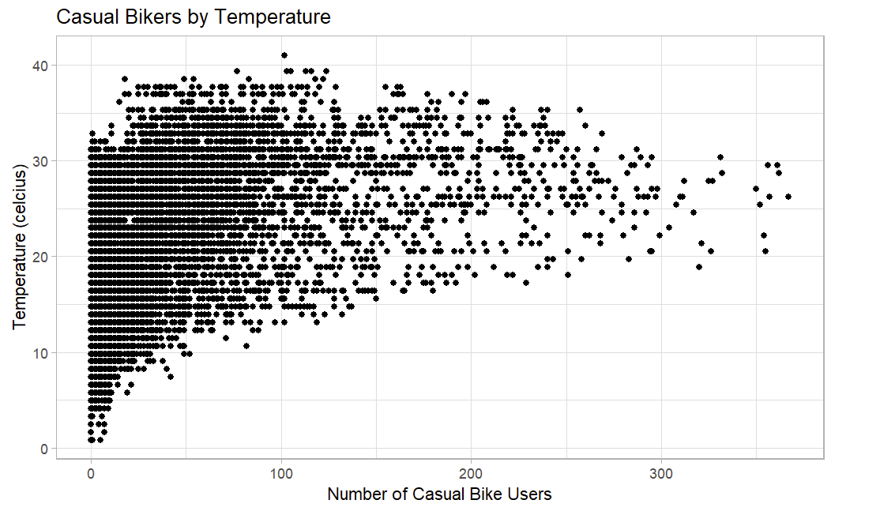
SMART Question: When do casual bikers increase the most?
The number of casual bike rentals increased when temperatures increased but dropped off once temperatures started reaching the high 30s (Celsius). Majority of them rented bikes on days where temperature was between 20-30 degrees.

Slide 11
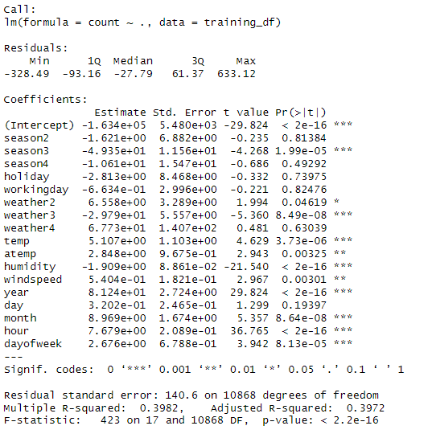
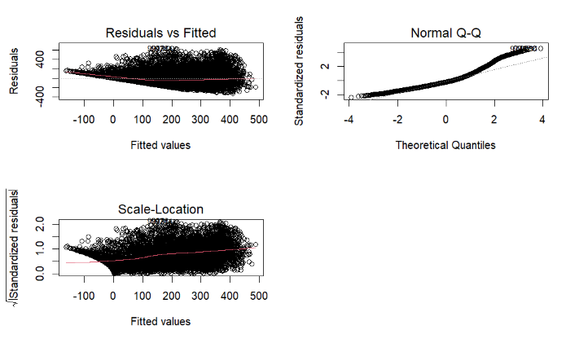
Linear Model (Model 1)
To answer the bigger question of how to predict the number of rentals in a city and the more specific SMART Question: Which variables are useful for predicting the number of bikes used in an hour, a linear model was used including all the variables available
Excludes casual and registered because they add up to the count
Reformatted datetime into year, day, month, and hour
Made weather and season into factors
However, based on the results of the residuals vs fitted plot, the variance of residuals increased as the values increased. A log transformation was considered to see if there was a model with more constant variance.

Slide 12
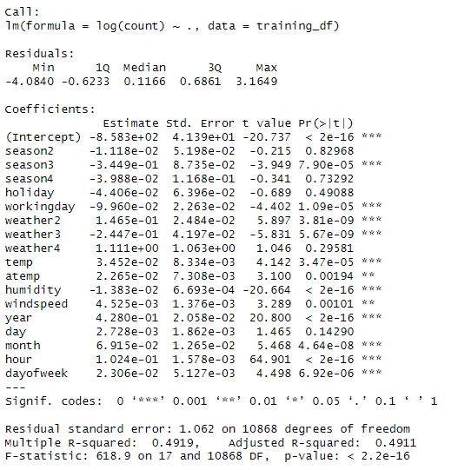
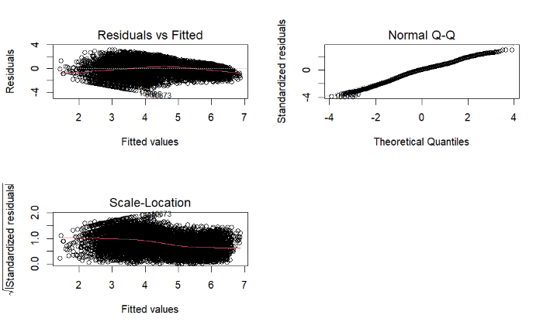
Log Transformation (Model 2)
After running the log transformation, the residuals vs fitted plot no longer increased as the values increased. The qq-plot also shows that normality is a reasonable assumption.

Slide 13
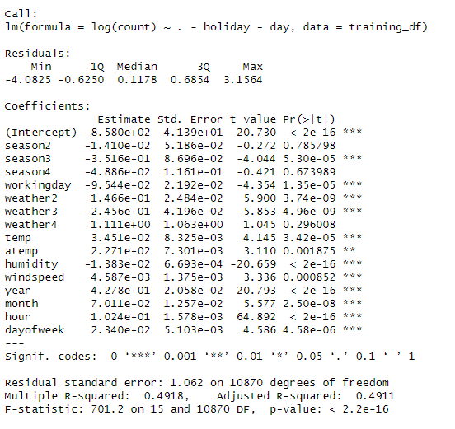
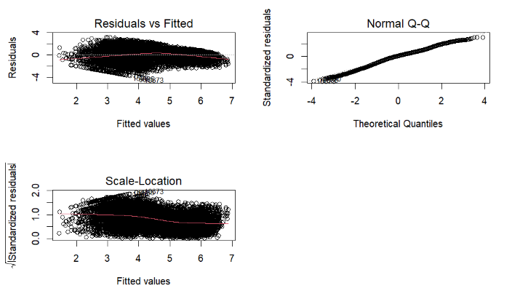
Model Selection (Model 3)
To create a parsimonious model and remove unnecessary variables, ‘holiday’ and ‘day’ were taken out of this model based on the p-values of the previous log model (model 2).
The qq-plot again shows that normality is a reasonable assumption.
Notes:
Parsimonious= as few variables as possible

Slide 14
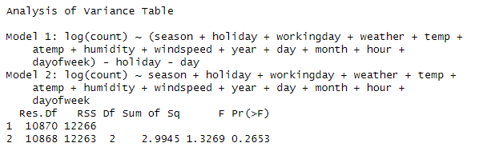
ANOVA
Model 3 was then compared to Model 2.
Null Hypothesis: Model 3 is a reasonable fit
Alternative Hypothesis: Model 2 is a reasonable fit
The p-value is greater than 0.05, so we do not reject the null hypothesis, which means Model 3 is adequate to model the rentals. There's no evidence that including ‘holiday’ and ‘day’ improves the model's fit.
3

Slide 15
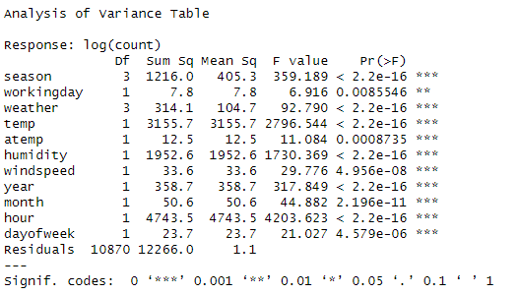
ANOVA on Final Model
The ANOVA run shows that all variables in Model 3 are statistically significant due to the p-values.
This means that removing any more variables would reduce model fit.
In conclusion, this would be a reasonable model for predicting number of rentals.

Slide 16
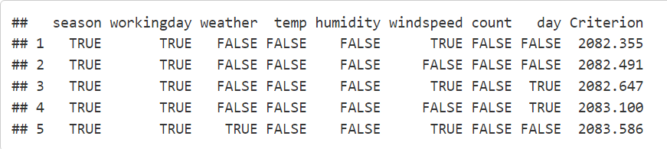
Logit Model
To answer the SMART question: Can we estimate when it is a holiday depending on other bikeshare factors, a logit model was used due to holiday being a categorical variable.
‘year’, ‘month’, ‘hour’, and ‘dayofweek’ were excluded logically based on how holidays work
‘atemp’ was excluded since ‘temp’ is already in the dataset
Made workingday into a factor
Based on running bestglm, the best model was found to only be influenced by `season`, `windspeed` and `workingday`, with an AIC of 2082.

Slide 17
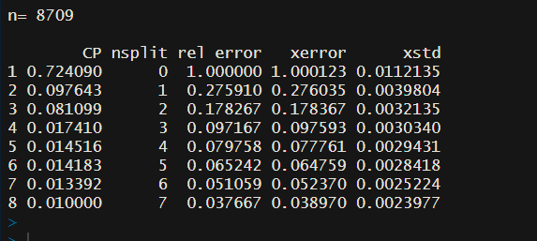
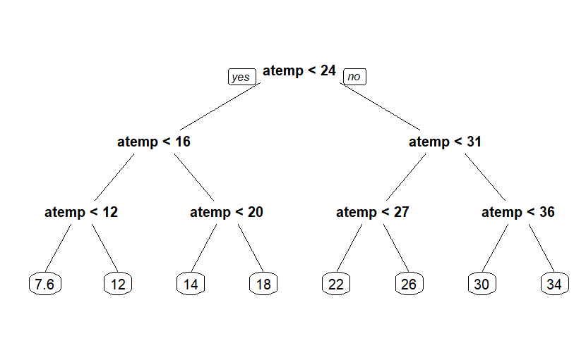
Taking Temperature as Response Variable (Decision Tree vs. Random Forest)
To predict temperature on a particular day we have trained a decision tree as well as a Random forest which can be imported from r-part package in R.
The following results are generated when we fit decision tree on training data
While training decision tree we have kept minimum split as 5
Minimum split is the parameter used to specify the minimum number of observations that must exist in the node for a split to be attempted during construction of a decision tree. In other words, algorithm will only attempt to split a node if the number of observations in that node is greater than or equal to the specified minimum split value.

Slide 18
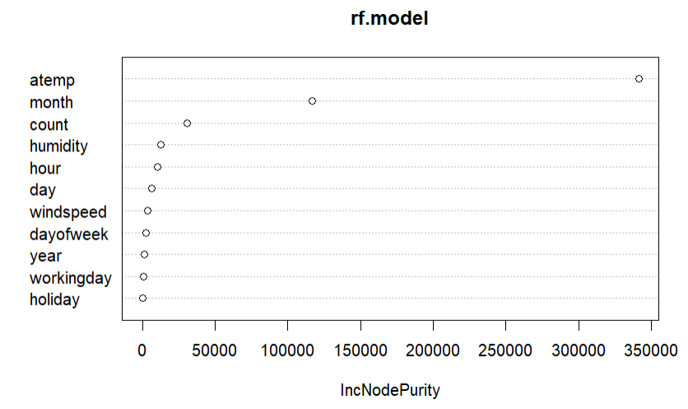
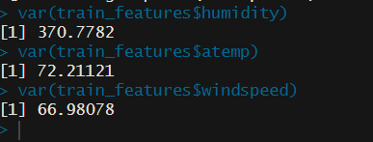
Predictions generated using RFM
After generating the predictions using decision tree, we trained a random forest model because there is a substantial difference between the variance of different features, so to handle this problem we have trained a random forest model which has a built in regularization to minimize overfitting and can handle datasets with varying feature importance

Slide 19
Best fit (decision tree vs random forest)
We are using RMSE i.e. Root mean squared error as the evaluation metric to check which is the better model between decision tree and random forest
Reason for picking RMSE as eval metric : RMSE is in the same units as the target variable making it interpretable, it gives clear idea of the average magnitude of errors in the original scale of the response variable, moreover it is sensitive to outliers which can be beneficial when you want the model to be penalized more for larger discrepancies
RMSE for random forest is 0.5789
RMSE for decision tree is 1.6393
Clearly random forest is the best fit out of these two to predict the temperature

Slide 20
Conclusion
SMART Questions
Which variables are useful for predicting the number of bikes used in an hour?
All variables other than ‘holiday’ and ‘day’ are useful for predicting the number of bikes used in an hour.
How does temperature affect the number of bikes in use?
The temperature graph show bikers increase with higher temperatures. The final model also shows a slight increase in the number of bikers when temperature increases.
When do casual bikers increase the most?
Again, the temperature graph showing casual bikers specifically shows that bikers increase with higher temperatures, with majority of them renting bikes on days where temperature is between 20-30 Celsius.
Can we estimate when it is a holiday depending on other bikeshare factors?
Yes, the best model for finding out if a day is a holiday is based on `season`, `windspeed` and `workingday`.
How can we predict temperature depending upon other important features?
The best model based on random forest and decision tree to estimate the temperature is by using the features ‘humidity’, ‘windspeed’, and ‘datetime’

Slide 21
References
Black, C., and S. Potter. Undated. Portsmouth bikeabout: A smart-card bike club scheme. http://www.metrobike.net/index.php?s=file_download&id=11/.
DeMaio, P. 2003. Smart bikes: Public transportation for the 21st century. Transpor tation Quarterly 57(1): 9–11.
DeMaio, P. 2004. Will smart bikes succeed as public transportation in the United States? Journal of Public Transportation 7(2): 1-15.
DeMaio, P. 2007. What a year for bike-sharing. December 30. http://bike-sharing.blogspot.com/2007/12/what-year-for-bike-sharing.html/.
DeMaio, Paul. 2008a. Bike-sharing Wrap-up for 2008. December 31. http://bike sharing.blogspot.com/2008/12/bike-sharing-wrap-up-for-2008.html/.
DeMaio, P. 2008b. University bike-sharing’s time has come. The Bike-sharing Blog. October 26. http://bike-sharing.blogspot.com/2008/10/university-bike-shar ings-time-has-come.html/.
MetroBike. 2009. The Bike-sharing world map. http://maps.google.com/maps/ ms?ie=UTF8&hl=en&om=1&msa=0&msid=104227318304000014160.00043d80f9456b3416ced&ll=43.580391,-42.890625&spn=143.80149,154.6875&z=1 &source=embed/
Nielse, B. H. 1993. The Bicycle in Denmark: Present Use and Future Potential. Danish Ministry of Transport. 52
Optimising Bike Sharing in European Cities. 2009a. France. FR_Rennes_Old System tab. http://www.obisproject.com/palio/html.run?_Instance=obis&_PageID=4&_LngID=21&_CatID=722&pic=4&_CheckSum=1012982978/.
Optimising Bike Sharing in European Cities. 2009b. Germany. DE_Berlin tab.http://www.obisproject.com/palio/html.run?_Instance=obis&_PageID=4&_ LngID=21&_CatID=722&pic=4&_CheckSum=1012982978/.
Optimising Bike Sharing in European Cities. 2009c. France. FR_Lyon tab. http:// www.obisproject.com/palio/html.run?_Instance=obis&_PageID=4&_ LngID=21&_CatID=722&pic=4&_CheckSum=1012982978/Schimmelpennick, L. 2009. Conversation with author. March 5
Cukierski, W. (2014). Bike Sharing Demand. Kaggle. https://www.kaggle.com/competitions/bike-sharing-demand/overview

